Slide 1
Integrity constraints
19

Slide 2
Contents
Integrity constraints
Domain integrity
Entity integrity
Referential integrity
Key integrity

Slide 3
Integrity constraints
Integrity constraints in Database Management Systems (DBMS) are a set of rules that are applied on the table columns or relationships to ensure that the overall validity, integrity, and consistency (i.e. the quality) of the data present in the database table is maintained. Each and every time a table insert, update, delete, or alter operation is performed, it is evaluated against the terms or rules mentioned in the integrity constraint. The data is inserted, updated, deleted, or altered only if the result of the constraint comes out to be True. Thus, integrity constraint prevents accidental damage to the database by an authorized user.

Slide 4
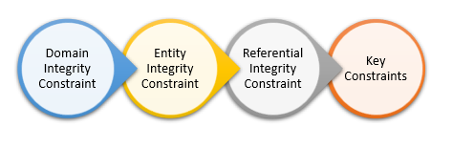
Types of Integrity Constraints in DBMS

Slide 5
Domain Integrity Constraint
A domain integrity constraint is a set of rules that restricts the kind of attributes or values a column or relation can hold in the database table. For example, we can specify if a particular column can hold null values or not, if the values have to be unique or not, the data type or size of values that can be entered in the column, the default values for the column, etc.
For example, we want to create a “customer_details” table, with information such as customer id, customer name, the number of items purchased, date of purchase, etc. So, in order to ensure domain integrity, we can specify the customer_id has to be unique, the quantity of items purchased has to be an integer number only and the date of purchase has to be a date or timestamp, etc.

Slide 6
Domain Integrity Constraint
CREATE TABLE customer_details
(
customer_id character varying(255) NOT NULL,
customer_name character varying(255) NOT NULL,
quantity integer NOT NULL,
date_purchased date
);

Slide 7
Entity Integrity Constraint
Entity Integrity Constraint is used to ensure the uniqueness of each record or row in the data table. There are primarily two types of integrity constraints that help us in ensuring the uniqueness of each row, namely, UNIQUE constraint and PRIMARY KEY constraint.
The unique key helps in uniquely identifying a record in the data table. It can be considered somewhat similar to the Primary key as both of them guarantee the uniqueness of a record. But unlike the primary key, a unique key can accept NULL values and it can be used on more than one column of the data table.

Slide 8
Entity Integrity Constraint
CREATE TABLE Students(
Student_ID number(5) NOT NULL,
Student_Name varchar(255) NOT NULL,
Class_Name varchar(255) UNIQUE,
Age int,
PRIMARY KEY (Student_ID)
);

Slide 9
Referential Integrity Constraint
Referential Integrity Constraint ensures that there always exists a valid relationship between two tables. This makes sure that if a foreign key exists in a table relationship then it should always reference a corresponding value in the second table or it should be null.

Slide 10
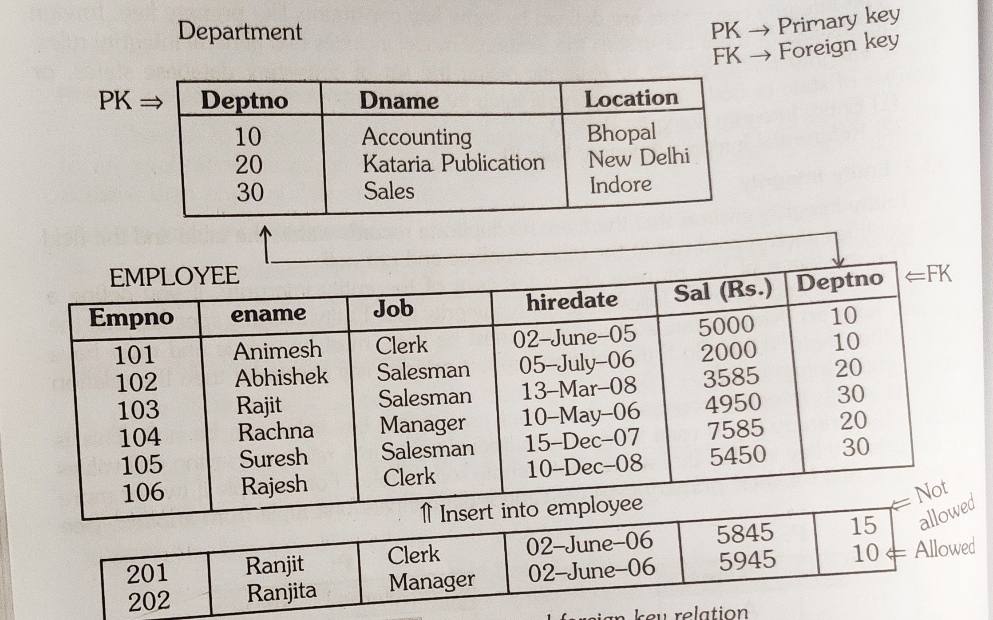
Referential Integrity Constraint

Slide 11
Key Constraints
There are a number of key constraints in SQL that ensure that an entity or record is uniquely or differently identified in the database. There can be more than one key in the table but it can have only one primary key.
Some of the key constraints in SQL are :
Primary Key Constraint
Foreign Key Constraint
Unique Key Constraint

Slide 12


